Slide 1
Mini Project: Kaban Board for To-Do List App. Up and Grateful PLC.
Abigeal Akpobasa• 05.04.2025
Notes:
Welcome! This presentation is about a mini project carried out at Up and Grateful PLC, where we created a Kanban board to manage the development of a simple To-Do List app.

Slide 2
Project Overview
Objective
Build a To-Do List App
Problem
Long lists and chaotic task planning
Solution
Use the Kanban Technology to streamline the workflow. Tool
Trello
Notes:
We were tasked with developing a basic to-do list application. We adopted the Kanban methodology to manage our tasks using Trello to avoid confusion and improve clarity.

Slide 3
What is Kanban?
A visual workflow system
Tracks tasks across 3 columns: To Do, In Progress, Done
Promotes task focus and reduces bottlenecks
Notes:
Kanban is ideal for visualizing workflows. It helps teams stay on track by focusing on what’s currently being worked on, what’s pending, and what’s completed.

Slide 4
Setting Up the Board
Columns created
To Do (Backlog)
In Progress
Done
Initial Tasks
Create task feature
Add categories
Add priority levels
Completion notifications
Bug testing
App deployment
Notes:
We created three standard Kanban columns and populated the board with the major features of the To-Do List app. This helped break down the work into manageable pieces.

Slide 5
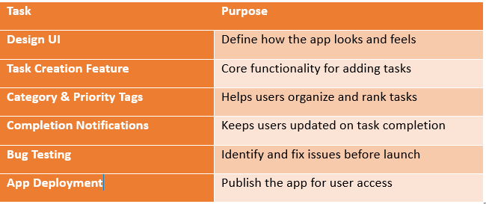
Breakdown of Tasks
Notes:
Here’s how each task contributed to building a usable product. Each step was critical in taking the app from idea to release.

Slide 6
Organizing Tasks and Managing Task Workflows
Organizing Tasks
Team members pull tasks into In Progress
Completed tasks are moved to Done
Tasks are clearly assigned and tracked
Managing Tasks
Only 1 task per person in "In Progress" by setting limit using power-ups.
Must complete a task before picking another
Notes:
As team members started work, they moved items into the "In Progress" column. Once a task was done, it was transferred to "Done," helping everyone see the project’s flow.
To prevent multitasking and confusion, we limited each person to one active task. This rule helped us stay focused and productive.

Slide 7
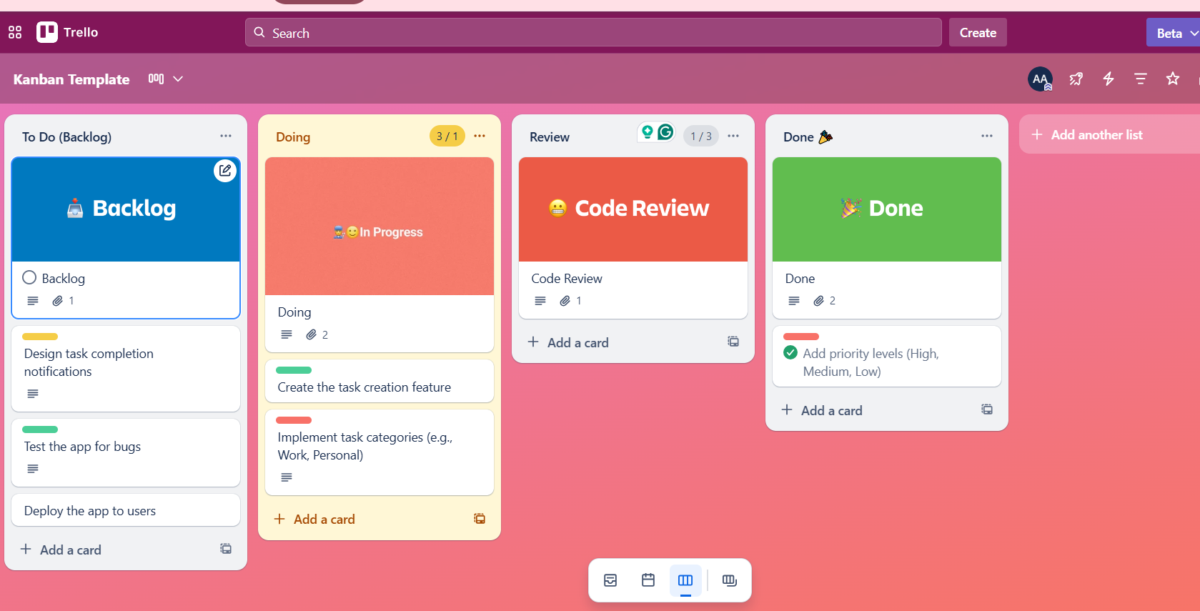
Kanban Board for the To-Do List App
https://trello.com/b/QJLGYvSu/kanban-template
Notes:
Here is the Kanban board as used in Trello, showing how tasks were distributed across the workflow.

Slide 8
Scrum Framework
Roles
Product Owner – defines the vision
Scrum Master –facilitates the process
Development Team – executes tasks
Events
Sprint Planning
Daily Scrum,
Sprint Review,
Retrospective
Artifacts
Product Backlog
Sprint Backlog
Increment
Notes:
Scrum is another Agile framework that uses defined roles, fixed-length sprints, and structured meetings to drive delivery.

Slide 9
Scrum Framework
Events
Artifacts
Roles
Sprint Planning
Daily Scrum
Sprint Review
Retrospective
Product Owner – defines the vision
Scrum Master –facilitates the process
Development Team – executes tasks
Product Backlog
Sprint Backlog
Increment
Notes:
Scrum is another Agile framework that uses defined roles, fixed-length sprints, and structured meetings to drive delivery.

Slide 10
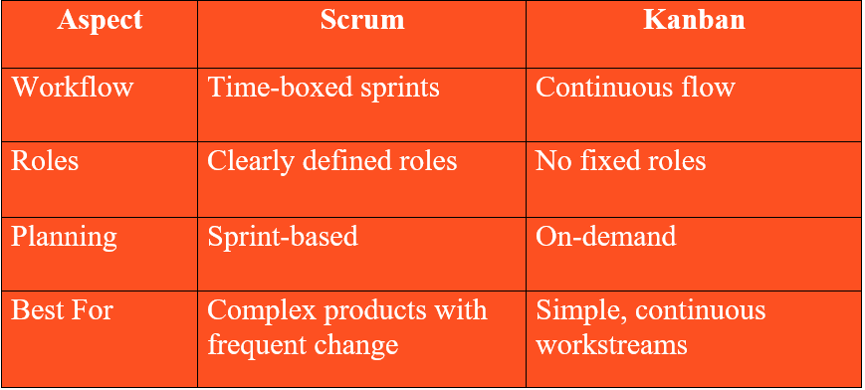
Scrum VS Kanban
Notes:
Scrum vs Kanban Scrum:
Fixed sprints
Roles: Product Owner, Scrum Master
Time-boxed iterations
Kanban:
Continuous flow
No defined roles
WIP limits instead of sprints
Scrum and Kanban are both agile frameworks but differ in structure. Scrum uses strict time-boxed sprints, while Kanban offers flexibility and visual management.

Slide 11
Conclusion
Kanban streamlined our task management process
Team collaboration improved through visual workflows
Agile principles enhanced project clarity and delivery
Practical application deepened our understanding of task prioritization and flow
Notes:
In conclusion, using the Kanban methodology allowed our team to break down complex tasks into clear, visual steps, improving collaboration and focus. This hands-on experience showed how agile practices, especially visual ones that can turn chaotic processes into smooth, well-managed workflows. It reinforced the power of prioritization, flow, and team autonomy in delivering great results. Thank you!

